Slide 1

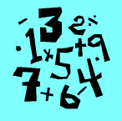

ATAR CHEMISTRY
CALCULATIONS

Slide 2



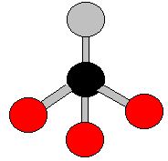





LAW of CONSERVATION of MATTER
+
→
+
→
+
+
+

Slide 3
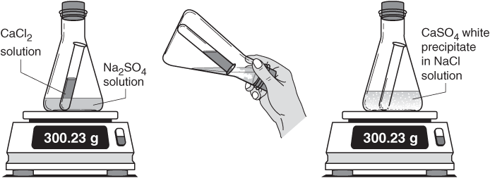
LAW of CONSERVATION of MATTER
► The law of conservation of mass/matter, also known as law of mass/matter conservation , states that the MASS of a CLOSED SYSTEM will remain constant, regardless of the processes acting inside the system. An equivalent statement is that matter cannot be CREATED NOR DESTROYED, although it may be rearranged. This implies that for any chemical process in a closed system, the mass of the reactants must equal the mass of the products.

Slide 4
ONE KNOWN
ONE UNKNOWN
√
?

Slide 5
►Chemical equations are very like ‘cooking recipes’.
A recipe tells you the quantity of INGREDIENTS that are necessary to make something such as a cake. You may use the recipe to make one cake, two cakes or any number you wish. You will have to vary the quantity of ingredients depending on how many cakes you wish to make but the SAME recipe is used to give you the RATIO of ingredients necessary.
CAKE RECIPE:
1 kg FLOUR + 10 EGGS → 1 CAKE

Slide 6
We are asked to cater for two parties. -Mr POPULAR and Mr NOMATES.
Can we use the SAME recipe????
MR POPULAR requires 10 CAKES for his party.
How much ingredients??
CAKE RECIPE:
1 kg FLOUR + 10 EGGS → 1 CAKE
?
?
10
10 kg FLOUR
100 EGGS
10 CAKES

Slide 7
MR NOMATES will hold his party in a phone booth and unless he is very hungry, HALF a cake should be heaps!!
Can we use the SAME recipe????
CAKE RECIPE:
1 kg FLOUR + 10 EGGS → 1 CAKE
?
?
0.5
0.5 kg FLOUR
5 EGGS
0.5 CAKES

Slide 8
► Chemical Equations are like Cake Recipes. They give the ratio of ingredients (REACTANTS) used to make a certain amount of Cake (PRODUCTS).
► They give GENERAL relationships between MOLES of REACTANTS and MOLES of PRODUCTS.
►The ratios DO NOT work for gram masses!
► We will call these GENERAL ratios:
“MOLE RELATIONSHIPS”

Slide 9
“MOLE RELATIONSHIPS”
► A STOICHIOMETRIC ratio must always be established between the UNKNOWN chemical and the KNOWN chemical.
► The unknown must appear on the left hand side of the algebraic expression.
EXAMPLE: Assume that information is given about the chemical with the √ and asked about the one with the ?.
√ ?
Zn_{(s)} + 2HCl_{(aq)} → ZnCl_{2(aq)} + H_{2(g)}
The amount of HCl is MORE than the amount of Zn as it has a bigger COEFFICIENT (balancing number) in front of it! It is TWICE as much.
? √
n(HCl) = 2 x n(Zn)

Slide 10
“MOLE RELATIONSHIPS”
► Try the following examples:
? √ MnO₂(s) + 4HCl(aq) → MnCl₂(aq) + 2H₂O(l) + Cl₂(g)
1.
? √
n(MnO₂) = ¼ x n(HCl)
√ ? MnO₂(s) + 4HCl(aq) → MnCl₂(aq) + 2H₂O(l) + Cl₂(g)
2.
? √
n(H₂O) = ½ x n(HCl)
? √ MnO₂(s) + 4HCl(aq) → MnCl₂(aq) + 2H₂O(l) + Cl₂(g)
3.
? √
n(HCl) = 4 x n(Cl₂)

Slide 11
“MOLE RELATIONSHIPS”
► Further examples:
? √
2NaCl(aq) +Pb(NO₃)₂(aq)→ 2NaNO₃(aq) + PbCl₂(s)
4.
? √
n(NaCl) = 2 x n(Pb(NO₃)₂)
? √
2NaCl(aq) +Pb(NO₃)₂(aq)→ 2NaNO₃(aq) + PbCl₂(s)
5.
? √
n(Pb(NO₃)₂) = n(PbCl₂)
√ ? 2NaCl(aq) +Pb(NO₃)₂(aq)→ 2NaNO₃(aq) + PbCl₂(s)
6.
? √
n(NaNO₃) = n(NaCl)

Slide 12
QUESTION 1
What mass of hydrochloric acid (HCl) is required to completely react with 196.2 grams of zinc (Zn)?

Slide 13
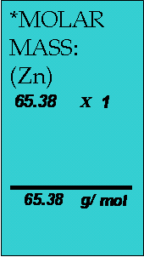
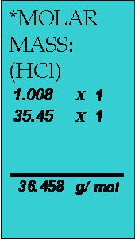
EQUATION:
√ ?
Zn_{(s)} + 2HCl_{(aq)} → ZnCl_{2(aq)} + H_{2(g)}
MASS → MOLES (√ ):
n(Zn) = m
*M
= 196.2
65.38
∴ n(Zn) = 3.00 mol
(Specific quantity of the known)
Solution
MOLE RELATIONSHIP (? →√):
n(HCl) = 2 x n(Zn) (General)
= 2 x 3.00 (Insert Specific quantity) ∴ n(HCl) = 6.00 mol (Mole quantity of unknown)
MOLES → MASS (? ):
m(HCl) = n(HCl) x M(HCl)
= 6.00 x 36.458
∴ m(HCl) = 218.7g or
= 219 g (3S.F.)

Slide 14
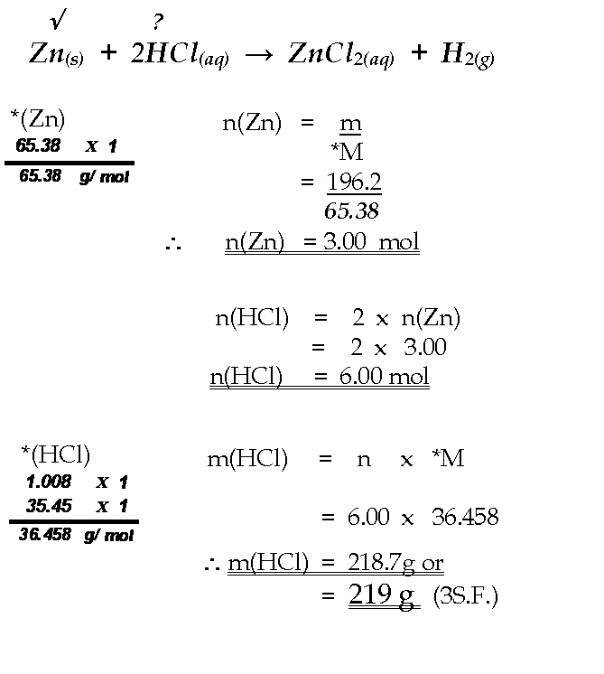
How should it look on your page?

Slide 15
QUESTION 2
What mass of ZnCl₂ will be produced when 146 grams of HCl is reacted with EXCESS (more than enough!) zinc metal?

Slide 16
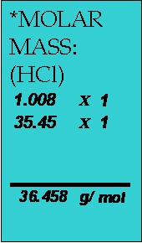
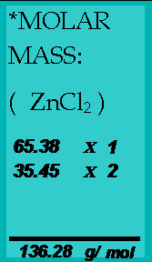
EQUATION:
√ ?
Zn_{(s)} + 2HCl_{(aq)} → ZnCl_{2(aq)} + H_{2(g)}
MASS → MOLES (√ ):
n(HCl) = m
*M
= 146
36.458
∴ n(HCl) = 4.00 mol
(Specific quantity of the known)
Solution
MOLE RELATIONSHIP (? →√):
n(ZnCl₂) = ½ x n(HCl) (General)
= ½ x 4.00 (Insert Specific quantity) ∴ n(ZnCl₂) = 2.00 mol (Mole quantity of unknown)
MOLES → MASS (? ):
m(ZnCl₂) = n(ZnCl₂) x M(ZnCl₂)
= 2.00 x 136.28
∴ m(ZnCl₂) = 272.56 g
or 273 g (3 S.F.)

Slide 17
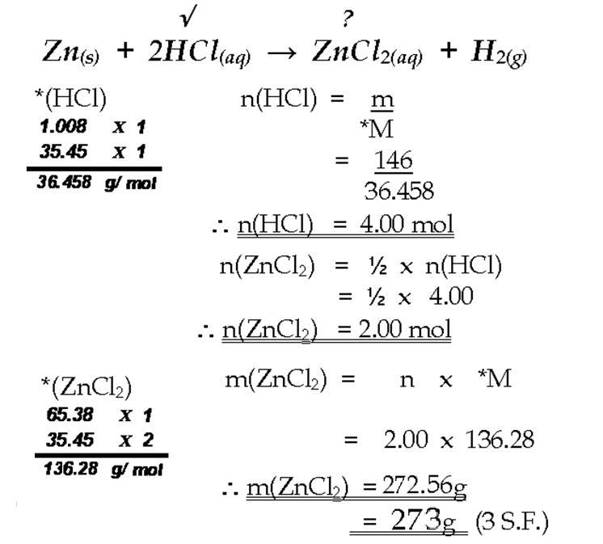
How should it look on your page?

Slide 18
QUESTION 3
Iron Oxide (Fe₂O₃) can be reduced in a blast furnace by carbon monoxide to produce liquid iron according to the following equation:
Fe₂O₃(s) + 3CO(g) → 2Fe(l) + 3CO₂(g)
How many grams of iron can be produced if 45 kg of iron oxide
are consumed in the process?

Slide 19
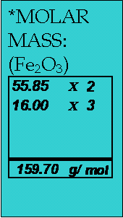

EQUATION:
√ ?
Fe₂O₃(s) + 3CO(g) → 2Fe(l) + 3CO₂(g)
MASS → MOLES (√ ):
n(Fe₂O₃) = m
*M
= 45,000 (45kg)
159.70
∴ n(Fe₂O₃) = 281.8 mol
(Specific quantity of the known)
Solution
MOLE RELATIONSHIP (? →√):
n(Fe) = 2 x n(Fe₂O₃) (General)
= 2 x 281.8 (Insert Specific quantity) ∴ n(Fe) = 563.6 mol (Mole quantity of unknown)
MOLES → MASS (? ):
m(Fe) = n(Fe) x M(Fe)
= 563.6 x 55.85
∴ m(Fe) = 31,477g or 31,500g
(3S.F.)

Slide 20
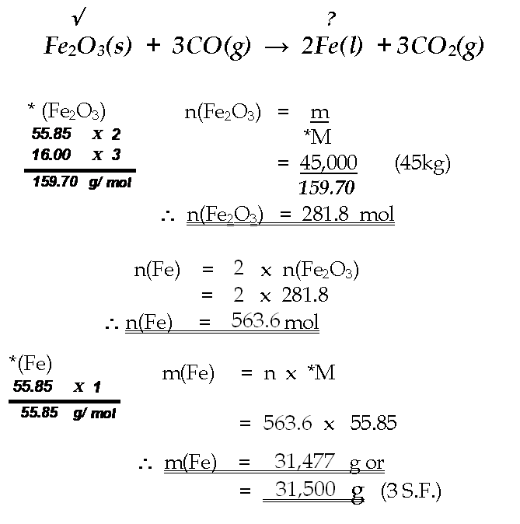
How should it look on your page?

Slide 21
QUESTION 4
When salt solution is added to lead nitrate solution a white precipitate of lead chloride is formed according to the following molecular equation:
2NaCl(aq) + Pb(NO₃)₂(aq) → 2NaNO₃(aq) + PbCl₂(s)
If a solution containing 225 grams of NaCl is added to an EXCESS of Pb(NO₃)₂ then what mass of lead chloride crystals could be filtered from the solution?

Slide 22
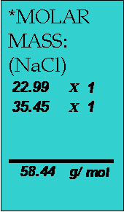
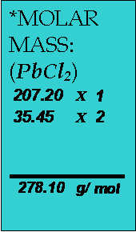
EQUATION:
√ ?
2NaCl(aq +Pb(NO₃)₂(aq)→ 2NaNO₃(aq) + PbCl₂(s)
MASS → MOLES (√ ):
n(NaCl) = m
*M
= 225
58.44
∴ n(NaCl) = 3.85 mol
(Specific quantity of the known)
Solution
MOLE RELATIONSHIP (? →√):
n(PbCl₂) = ½ x n(NaCl) (General)
= ½ x 3.85 (Insert Specific quantity) ∴ n(PbCl₂) = 1.925 mol (Mole quantity of unknown)
MOLES → MASS (? ):
m(PbCl₂) = n(PbCl₂) x M(PbCl₂)
= 1.925 x 278.10
∴ m(?) = 535 .3 g
= 535g (3 S.F)

Slide 23
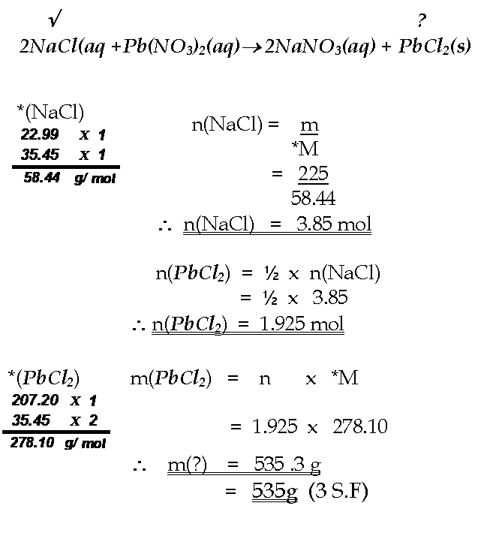
How should it look on your page?

Slide 24
TWO KNOWNS
ONE UNKNOWN
√
√
?
“LIMITING REACTANT”

Slide 25
QUESTION 5
How many grams of potassium sulphide (K₂S) can be produced if 205.27 grams of potassium metal are heated with 112.35 grams of sulphur according to the following equation?
2K(s) + S(s)  K₂S(s)

Slide 26
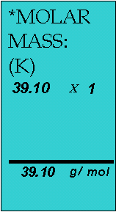
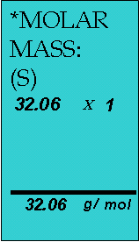
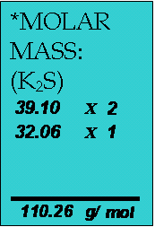
EQUATION:
√ √ ?
2K(s) + S(s)  K₂S(s)
MASS → MOLES (√ 1 ):
n(K) = m
*M
= 205.27
39.10
∴ n(K) = 5.25 mol
(Specific quantity of the first known)
MASS → MOLES (√ 2 ):
n(S) = m
*M
= 112.35
32.06
∴ n(S) = 3.50 mol
(Specific quantity of the second known)
LIMITING REACTANT JUSTIFICATION:
IF ALL (K) IS CONSUMED :
♦ n(S) = ½ x n(K)
= ½ x 5.25
∴ n(S) = 2.625 mol
We have more than enough Sulphur (S)!
∴ Potassium (K) IS LIMITING!!
MOLE RELATIONSHIP (? →√√):
n(K₂S) = ½ x n(K) (General)
= ½ x 5.25 (Insert Specific quantity) ∴ n(K₂S) = 2.625 mol (Mole quantity of unknown)
Solution
MOLES → MASS (? ):
m(K₂S) = n(K₂S) x M(K₂S)
= 2.625 x 110.26
m(K₂S) = 289.4 g = 289g (3S.F.)

Slide 27
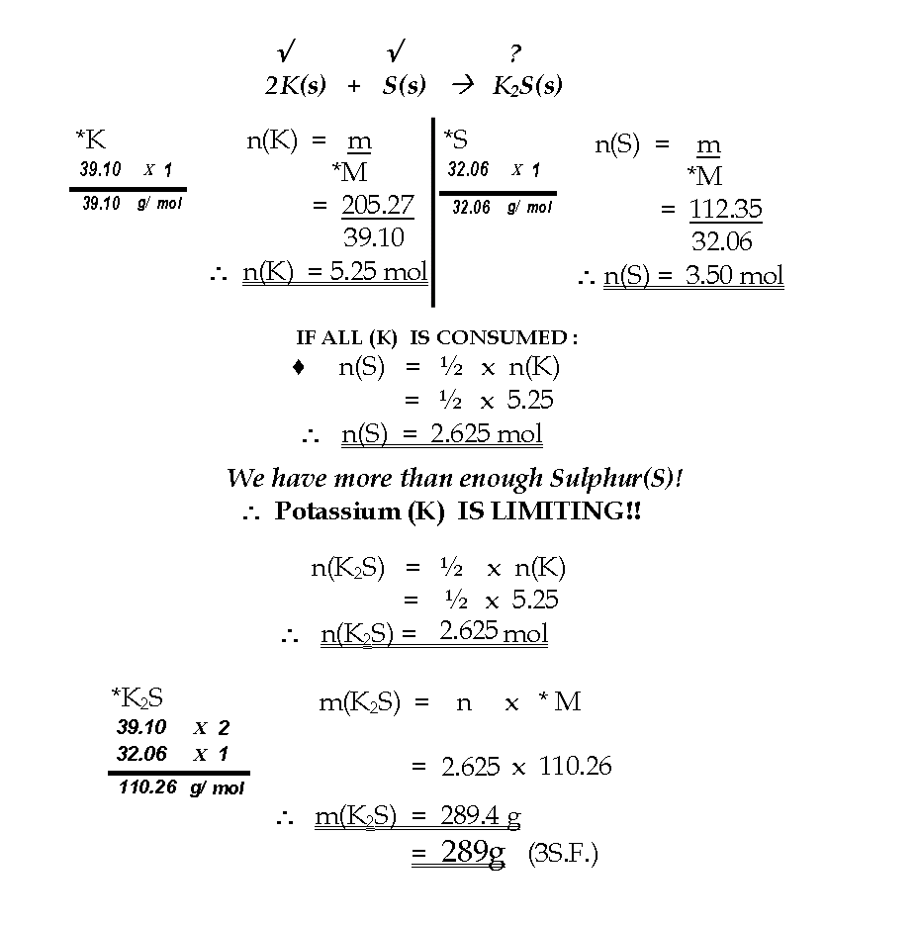
How should it look on your page?

Slide 28
QUESTION 6
Hydrochloric acid can be oxidised to chlorine (Cl₂) by oxidising agents such as manganese (IV) oxide:
MnO₂(s) + 4HCl(aq) → MnCl₂(aq) + 2H₂O(l) + Cl₂(g)
If 183g of HCl is reacted with 58g of MnO₂, what mass of Cl₂ will be produced?

Slide 29
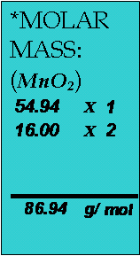
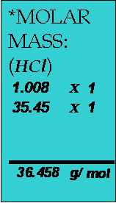
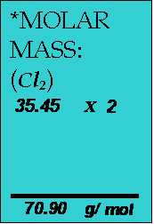
EQUATION:
√ √ ?
MnO₂(s) + 4HCl(aq) → MnCl₂(aq) + 2H₂O(l) + Cl₂(g)
MASS → MOLES (√ 1 ):
n(MnO₂) = m
*M
= 58
86.94
∴ n(MnO₂) = 0.667 mol
(Specific quantity of the first known)
MASS → MOLES (√ 2 ):
n(HCl) = m
*M
= 183
36.458
∴ n(HCl) = 5.019 mol
(Specific quantity of the second known)
LIMITING REACTANT JUSTIFICATION:
IF ALL (MnO₂) IS CONSUMED :
♦ n(HCl) = 4 x n(MnO₂)
= 4 x 0.667
∴ n(HCl) = 2.668 mol
We have more than enough HCl
∴ MnO₂ IS LIMITING
MOLE RELATIONSHIP (? →√√):
n(Cl₂) = n(MnO₂) (General)
= 0.667 (Insert Specific quantity) ∴ n(Cl₂) = 0.667 mol (Mole quantity of unknown)
Solution
MOLES → MASS (? ):
m(Cl₂) = n x *M
= 0.667 x 70.90
∴ m(Cl₂) = 47.29 g = 47.3 g (3 S.F.)

Slide 30
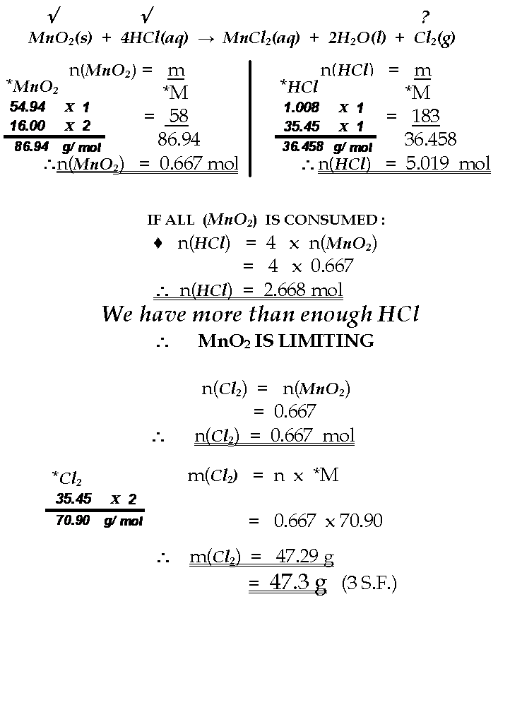
How should it look on your page?

Slide 31
ONE KNOWN
ONE UNKNOWN
√
?
“SERIAL EQUATIONS”

Slide 32
“SERIAL EQUATIONS”
► These examples concern situations where several stages of reaction are required in a synthesis to produce the desired product.
► Mole relationships cannot be constructed directly as coefficients in one equation have no bearing on those of completely different reactions. Linking compounds must be established and the relationship tracked.
√
4NH₃(g) + 5O₂(g)  4NO(g) + 6H₂O(g)
2NO(g) + O₂(g)  2NO₂(g)
?
3NO₂(g) + H₂O(l)  2HNO₃(aq) + NO(g)

Slide 33
METHOD: Assume that you have ONE mole of the known and determine the relative amount of the unknown. This ratio will always apply and can be used for any specific amount given in a question.
n(HNO₃) = ²/ 3 x n(NH₃)
√
4NH₃(g) + 5O₂(g)  4NO(g) + 6H₂O(g)
1
1
n(NO) = n(NH₃)
1
2NO(g) + O₂(g)  2NO₂(g)
1
n(NO₂) = n(NO)
1
?
3NO₂(g) + H₂O(l)  2HNO₃(aq) + NO(g)
n(HNO₃) = ²/ 3 x n(NO₂)
²/ 3

Slide 34
► Serial equation questions are very similar to a one known(√) one unknown(?) question. The only difference is that the mole relationship must be tracked through several stages.
► It is time consuming to copy all the stages of a synthesis and so this will not be required in your working. The synthesis should be used to track the mole relationship and this will appear in the solution to the question.

Slide 35
QUESTION 7
Calculate the mass of Nitric acid that can be manufactured from
20 tonnes of ammonia in the following synthesis:
4NH₃(g) + 5O₂(g)  4NO(g) + 6H₂O(g)
2NO(g) + O₂(g)  2NO₂(g)
3NO₂(g) + H₂O(l)  2HNO₃(aq) + NO(g)

Slide 36
As previously established :
√
4NH₃(g) + 5O₂(g)  4NO(g) + 6H₂O(g)
1
2NO(g) + O₂(g)  2NO₂(g)
?
3NO₂(g) + H₂O(l)  2HNO₃(aq) + NO(g)
²/ 3
20 tonnes
= 20 x 1,000 kg = 20,000 kg
= 20,000,000 g

Slide 37
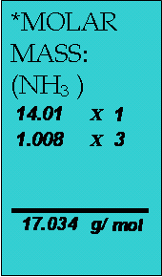
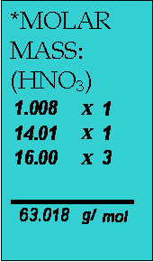
MASS → MOLES (√ ):
n(NH₃ ) = m
*M
= 20,000,000
17.034
∴ n(NH₃) = 1,174,122 mol
(Specific quantity of the known)
MOLE RELATIONSHIP (? →√):
n(HNO₃ ) = 2/3 x n(NH₃) (General)
= 2/3 x 1,174,122 (Insert Specific quantity) ∴n(HNO₃ ) = 781,965 mol (Mole quantity of unknown)
Solution
MOLES → MASS (? ):
m(HNO₃) = n x *M
= 781,965 x 63.018
∴ m(HNO₃) = 49,277,900g
= 49,300,000g (3 S.F.)
= 49.3 t

Slide 38
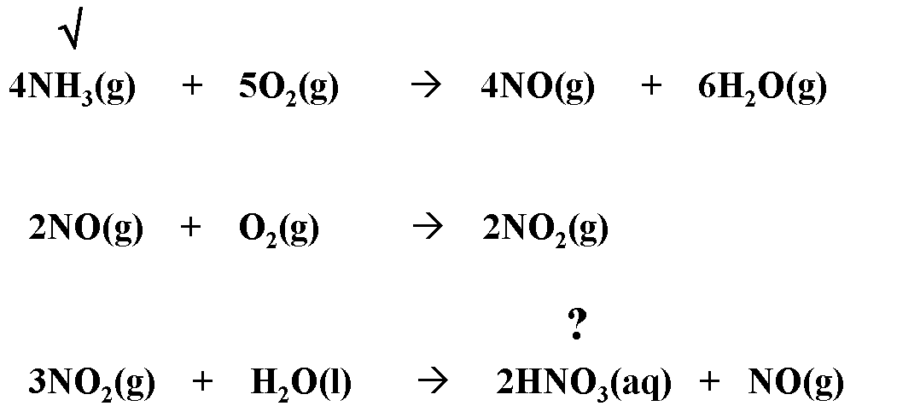

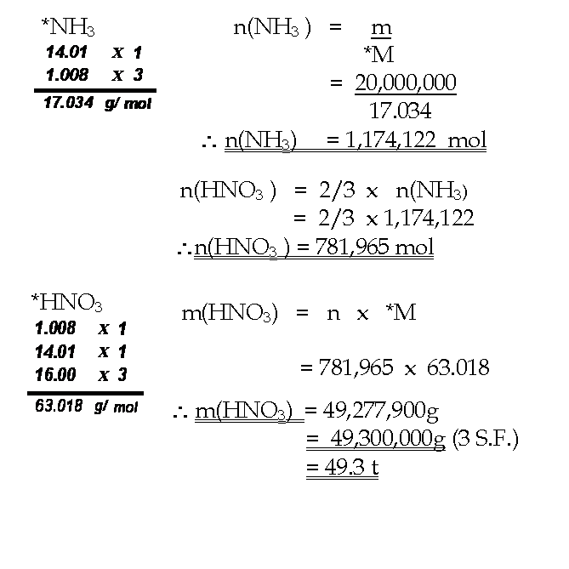
How should it look on your page?
1
1
1
1
1

